Slide 1


Laptop Wishlist
By : Muhammad Eric Syamir Bin Shamsurizal
ID : 22011778
Cancel

Slide 2









Laptops
Model
Price
Specification
Survey
Intro
Results
Log off...
Shut down...
Laptop Wishlist
Choosing the best laptop for students
Cancel

Slide 3









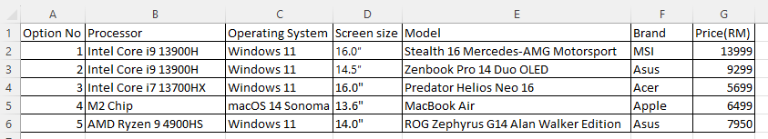
Laptop List and Specifications
Back
Forward
Stop
Refresh
Home
Search
Favorites
History
Address
https://www.microsoft365.com/launch/excel?auth=2/
Google
John is
John is 24 John is 5”9’ John has a cat (Fieri) John is an software engineer John studied in UCSD

Slide 4
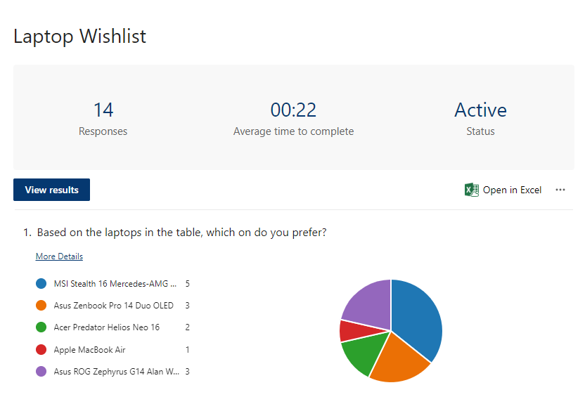
Windows Explorer
Back
Forward
Stop
Refresh
Home
Search
Favorites
History
Address
https://forms.office.com/
Google
John is
John is 24 John is 5”9’ John has a cat (Fieri) John is an software engineer John studied in UCSD

Slide 5





Windows Explorer
Back
Forward
Stop
Refresh
Home
Search
Favorites
History
Address
https://google.com/
Photos
Edit
View
Tools
Help
Google
The most chosen laptop is
MSI Stealth 16 Mercedes-AMG Motorsport

